Slide 1

HI6050 Capstone: Comprehensive Topic Selection and Supplementary Document
Supervisor: Dr. Farshid Keivanian
Session 5: Preparation for Group Final Report: Project Build & Final Report Writing Plan: Project Build & Final Report Writing Plan

Slide 2
Proposal Finalisation & Early Methodology
Objectives:
Integrate supervisor feedback into proposal.
Draft initial methodology and data collection plan.
Expand literature review to 12–15 quality sources.

Slide 3
Proposal Finalisation & Early Methodology
Tasks for Groups:
Finalize research aim, objectives, and research questions.
Draft literature review section in connected paragraphs, showing trends and contradictions in past work.
Continue building literature review.

Slide 4
Proposal Finalisation & Early Methodology
Literature Review Focus This Week:
Add regional or industry-specific studies (e.g., Australia, Asia-Pacific).
Include at least one framework/model relevant to your topic.
Compare strengths and weaknesses of different approaches.

Slide 5
Proposal Finalisation & Early Methodology
Do’s:
Ensure all in-text citations follow Adapted Harvard style.
Cross-check with assessment instructions.
Don’ts:
Avoid last-minute rush before proposal submission.
Don’t forget to link methodology to research question.

Slide 6
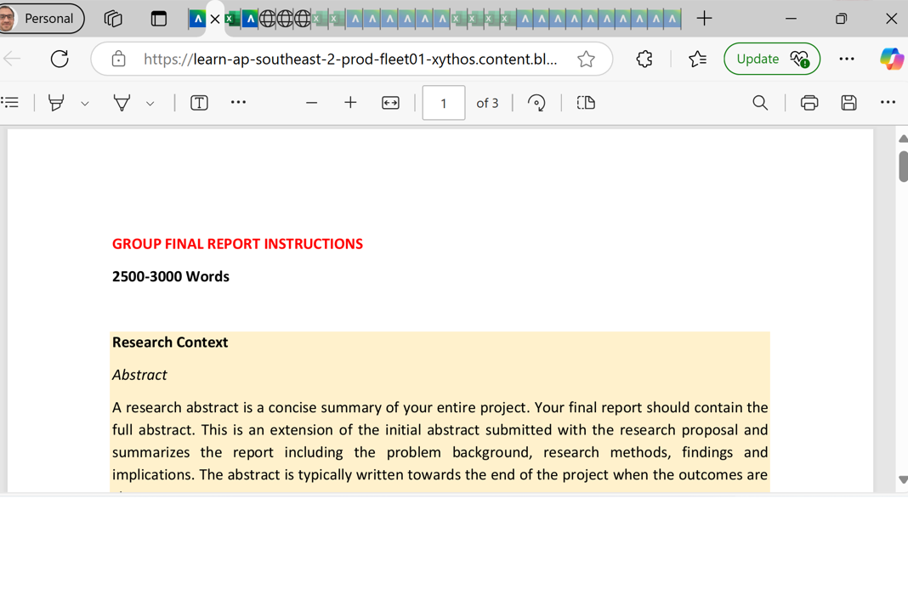
Preparation for Group Final Report: Project Build & Final Report Writing Plan

Slide 7
Preparation for Group Final Report: Project Build & Final Report Writing Plan
Project Build + Report Drafting (Independent Work + Weekly Check-ins)
Goals:
Begin technical work (e.g., coding, modeling, dashboarding)
Write the main report sections: Introduction, Methodology, Literature Review, Results, Discussion

Slide 8
Preparation for Group Final Report: Project Build & Final Report Writing Plan
What to Do:
Allocate roles: coder, document writer, reviewer
Use Agile-style standups (15 mins): what did we do, what’s next?
Use GitHub/Google Drive for collaboration

Slide 9
Preparation for Group Final Report: Project Build & Final Report Writing Plan
❌ What to Avoid:
Ignoring version control for report/code
Working last minute on results or analysis
Skipping documentation during development

Slide 10
Preparation for Group Final Report: Project Build & Final Report Writing Plan
Tips:
Start the report early – one section/week
Backup files regularly
Document failed attempts and what was learned

Slide 11
Preparation for Group Final Report: Project Build & Final Report Writing Plan
Example Guidance Based on Topics
Topic Example | Key Focus | Tools | Output
AI in Healthcare | Review use cases, challenges | Python, Scikit-learn, PubMed | Research Q: How effective is AI in early disease prediction?
Data Privacy Laws | Review global frameworks | Data scraping, legal archives | Research Q: How GDPR impacts corporate analytics?
Cybersecurity in E-commerce | Analyze breach cases | OWASP, PHP, MySQL | Research Q: What methods mitigate SQL injection attacks?
Data Analytics in Finance | Review fraud detection models | Python, Power BI | Research Q: Can ML detect real-time transaction fraud?

Slide 12
Preparation for Group Final Report: Project Build & Final Report Writing Plan
Resources to Provide Students
Literature Review Matrix Template (Excel)
Holmes Harvard Referencing Guide
Sample Proposal (Word)
Gantt Chart Template (Excel or PowerPoint)
Sample Abstracts and Research Questions
Session Slides (if you'd like, I can draft these)

Slide 13
Preparation for Group Final Report: Project Build & Final Report Writing Plan
Resources to Provide Students
Literature Review Matrix Template (Excel)
Holmes Harvard Referencing Guide
Sample Proposal (Word)
Gantt Chart Template (Excel or PowerPoint)
Sample Abstracts and Research Questions

Slide 14
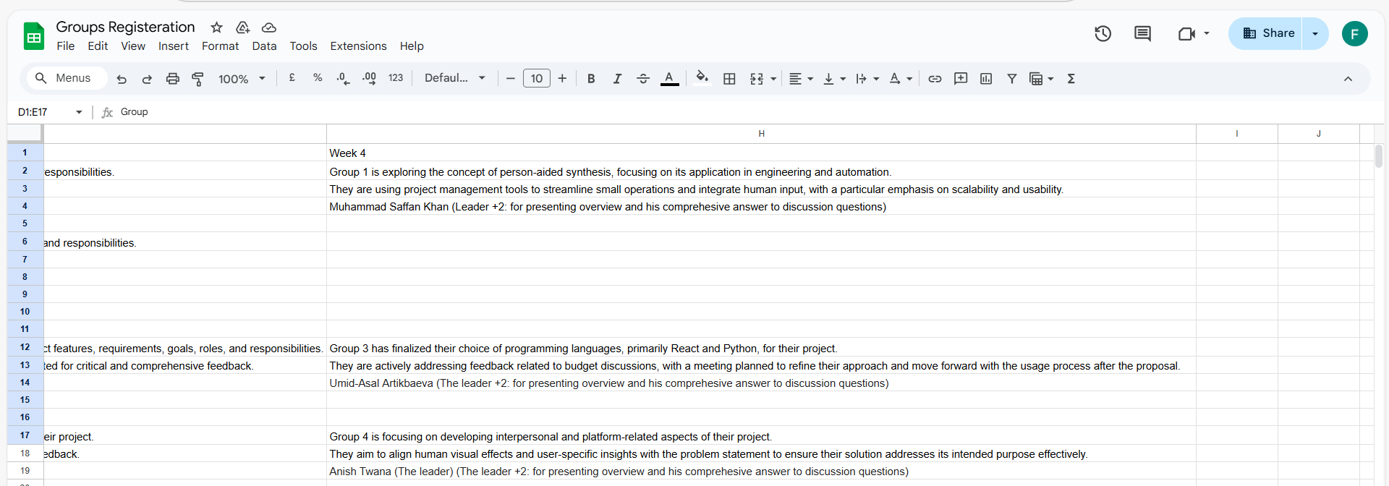
Group Progress Presentation – Overview of Progress at least 5 min

Slide 15
Thank You
Need Help? Send an email or ask during the tutorial session.
Good luck with your capstone journey!
Dr. Farshid Keivanian Capstone Project Supervisor Fkeivanian@my.holmes.edu.au

